Slide 1
Term Project: Drag and Drop
Moayed Aljaser, Adam Coard, and Amr Hassanein

Slide 2
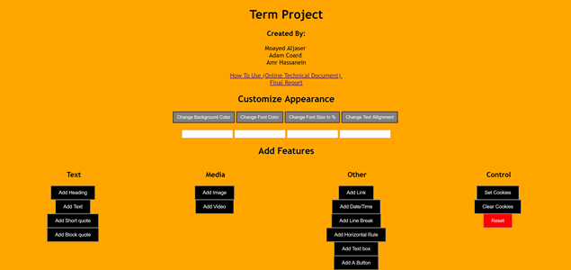
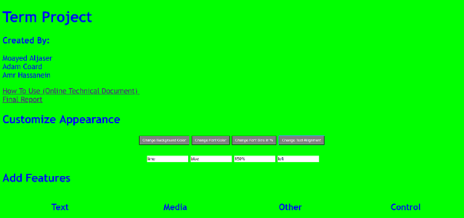
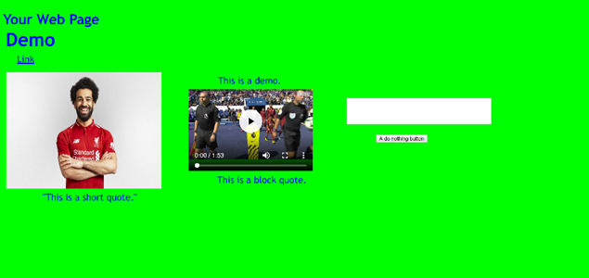
System Design
User Interface
Customized Appearance
Features Added

Slide 3
Implementation
Comprised of three files; an HTML file, CSS file, and a JavaScript file.
HTML file - main skeleton of the program, holds all the buttons that allow the user to add elements to their webpage.
Get element by id was implemented to connect between the buttons and the functions.
CSS file - code that styles the main website, changes elements like the website alignment, colors, fonts, etc.
JavaScript file - code that allows the user to drag and drop elements, set and clear cookies, and holds the code that implements the HTML and CSS elements that can be added to the user’s page which allow the user to manipulate with background color, font size, font color, and the text of page alignment or add elements.
This is the main part of the program because it will allow the user to move the elements position anywhere on the page.

Slide 4
Issues Encountered
Cookies
first issue run into while implementing the cookies was putting the entire <span> tag into a cookie
Clearing the cookies also did not work correctly at first
Separate page
Making the user page open in separate page from the command page
It was hard to make the span position to move in the new page, even when we used <div> tag to separate the page, the CSS modification didn’t not apply in the user <div> tag.
File names
When we first uploaded the project to pausch, the Javascript didn’t work just because the name of the Javascripts file was different from prj.

Slide 5
Conclusions
Very interesting.
Allowed us to use our creativity to produce a website that allows users to create their own website and change the position of elements on the page.
Allowed us to further our knowledge in the languages that we have previously learned.
Our program helped us learn more about the uses of JavaScript through the implementation of the drag and drop and cookie features.
We also learned a lot more about CSS just because we wanted to make the website look clean and lined up.
Future projects based off of this program would be to apply further upgrades and feature to the site. For example, we could allow the user to resize elements that are added to the website. We could also allow for the user to create a navigation bar or menu.

